Slide 1
VIRTUAL BRANCH ENVIRONMENT
New Sales Generation Tool
Neill Harris
Director Portfolio Marketing - Financial Services
April 2018

Slide 2
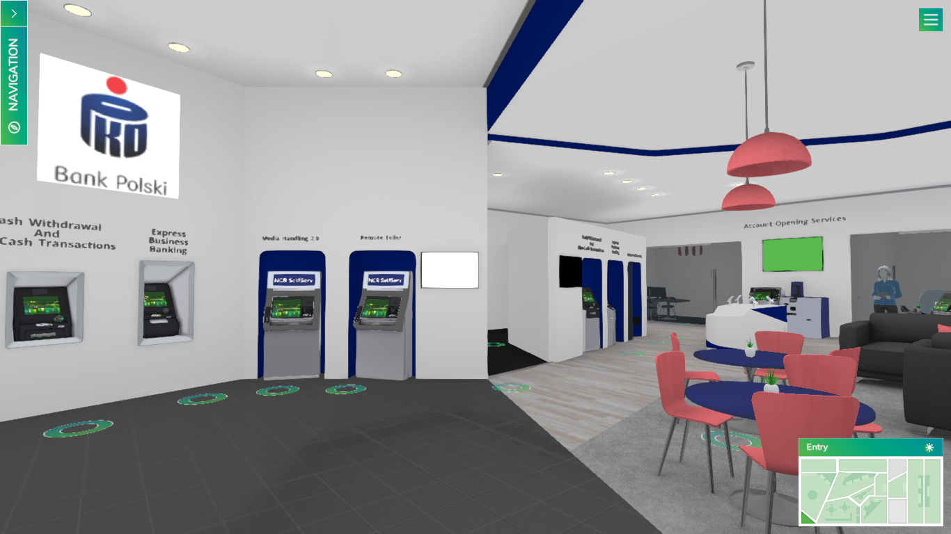
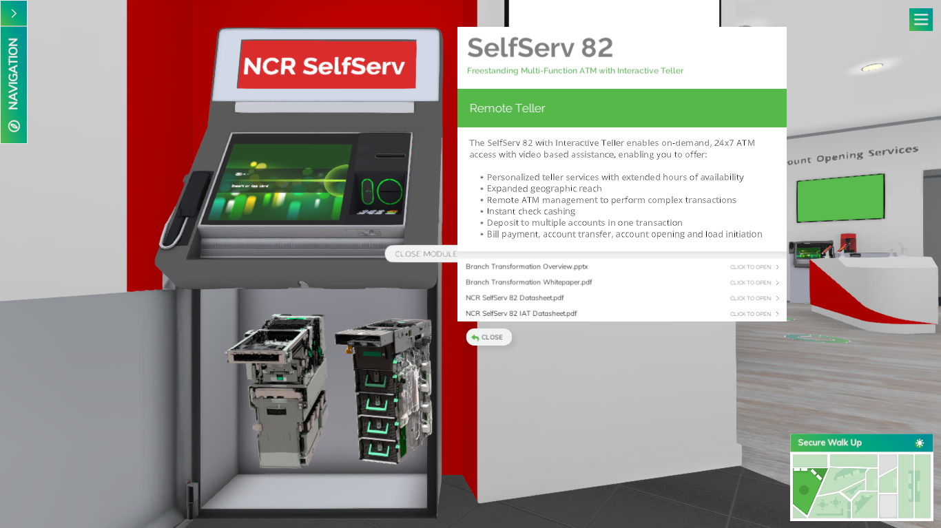
Virtual Branch Environment Overview
Why we created VBE?
Finding more engaging ways to interact with our customers and potential customers
Stand out from the crowd and our competitors
Invite your customers on a journey through NCR solutions.
What is it?
All solutions presented in an animated, interactive virtual branch environment (VBE) where user can navigate themselves and interact with our solutions.
All-in-one total solution marketing tool: HW, SW, branch, channel management (inc. cash management, device management, services, transaction monitoring)
We want to tell a total solution story. To position solutions from NCR in a combined, holistic approach.

Slide 3
Virtual Branch Environment Overview

Slide 4
Virtual Branch Environment Customizable

Slide 5
Virtual Branch Environment SelfServ 80 Series and Media Handling 2.0

Slide 6
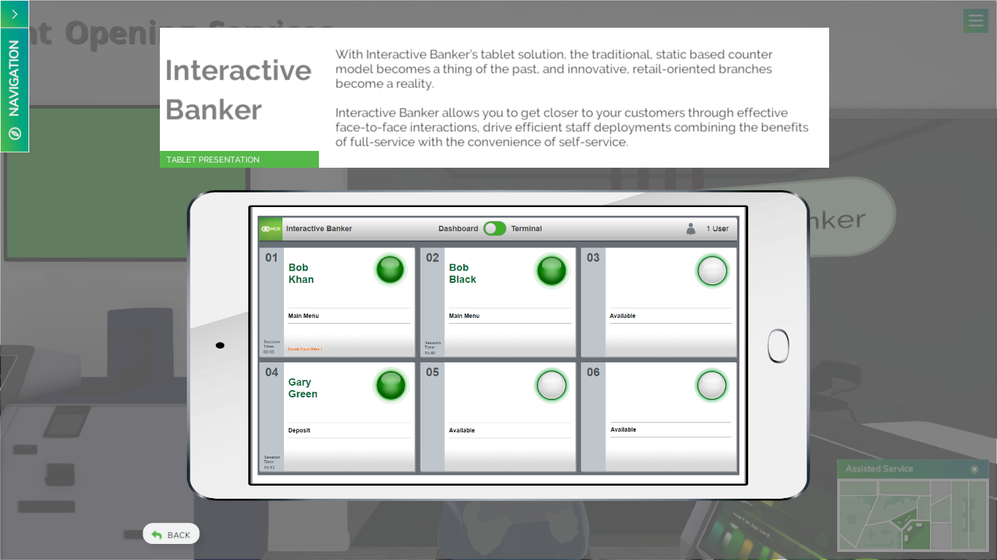
Virtual Branch Environment Interactive Teller and Banker

Slide 7
Thank you

